Slide 1

Pirai Infotech Private Limited
RAJESH.R
B.E-COMPUTER SCIENCE ENGINEERING

Slide 2
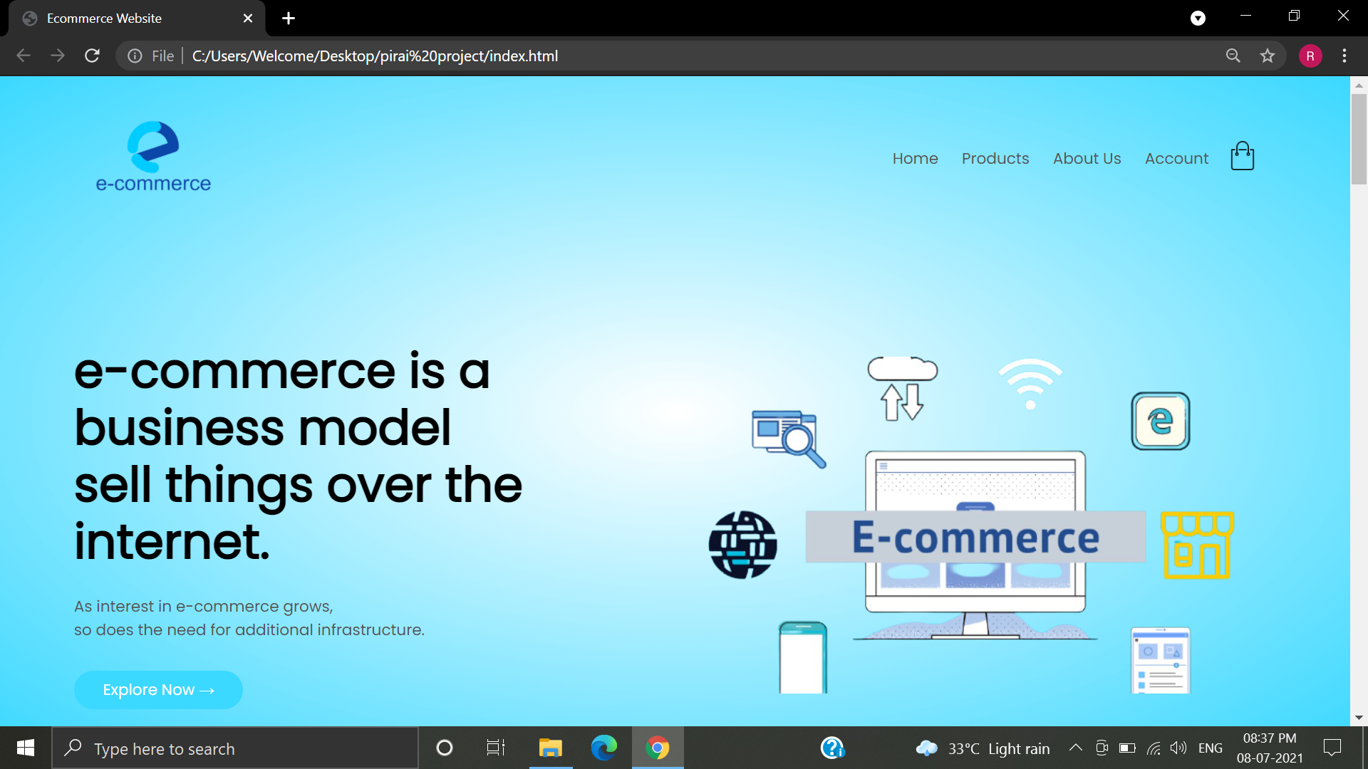
I have create a e-commerce website in html, css &javascript. And I add a four different pages like home,product,about us,account.

Slide 3
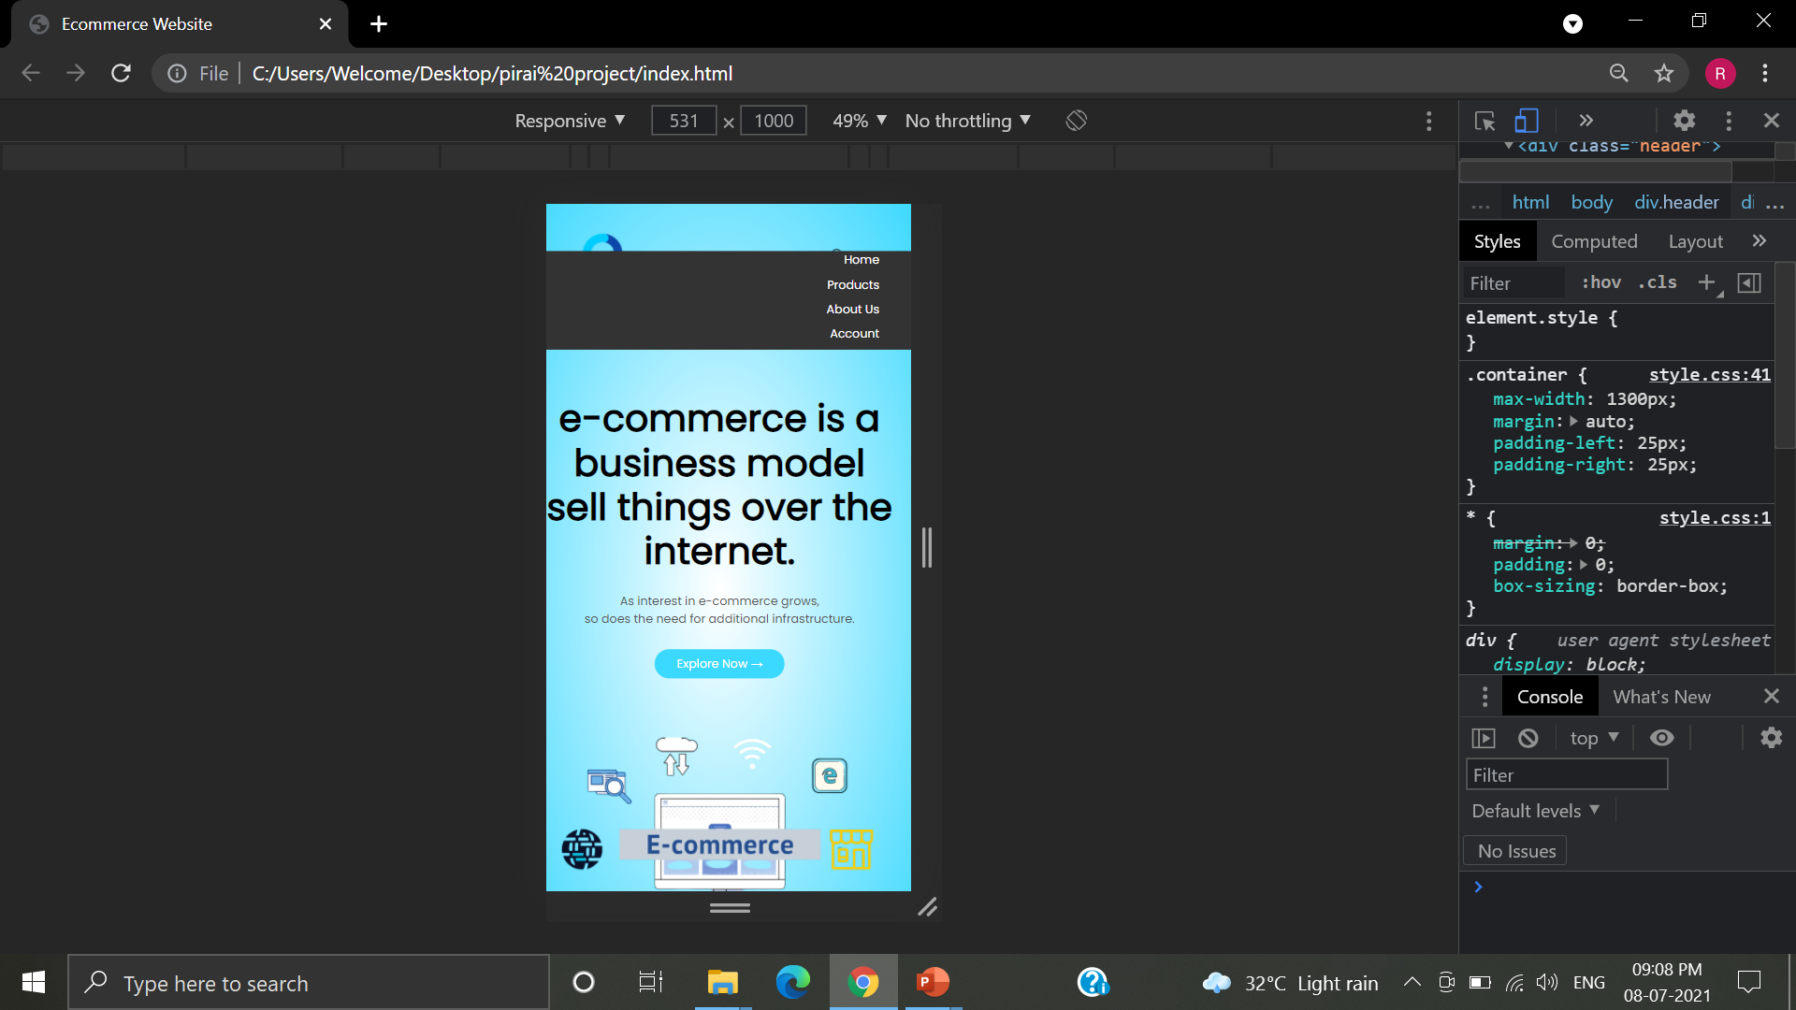
And I use Responsive for mobile view. In that I have add a menu icon which will shows the header content in toggle menu.

Slide 4
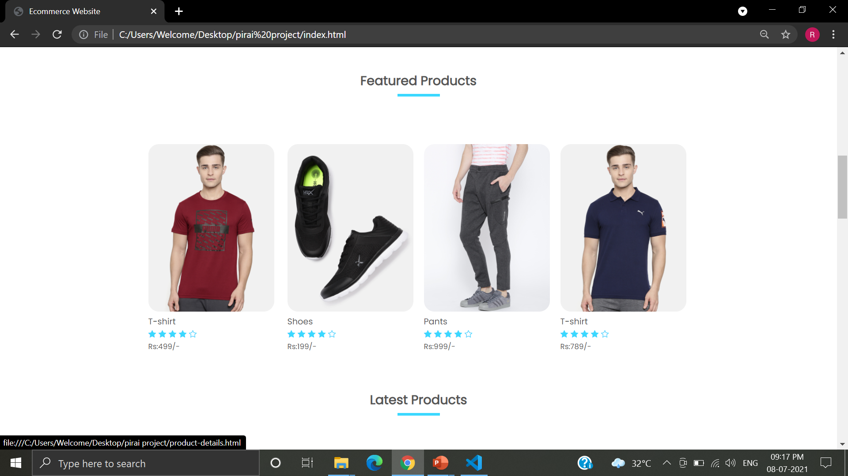
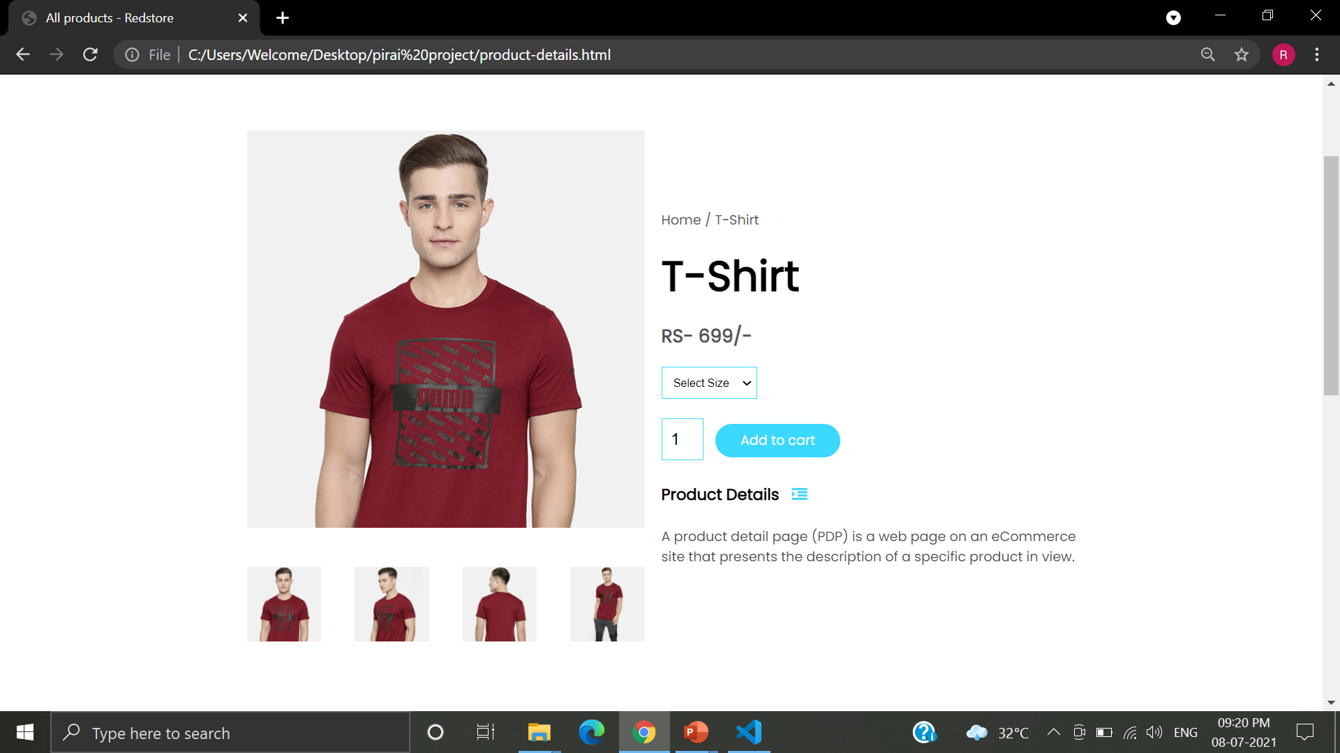
In features product when we click the t-shirt it will move to the product details which is show in right side image.

Slide 5

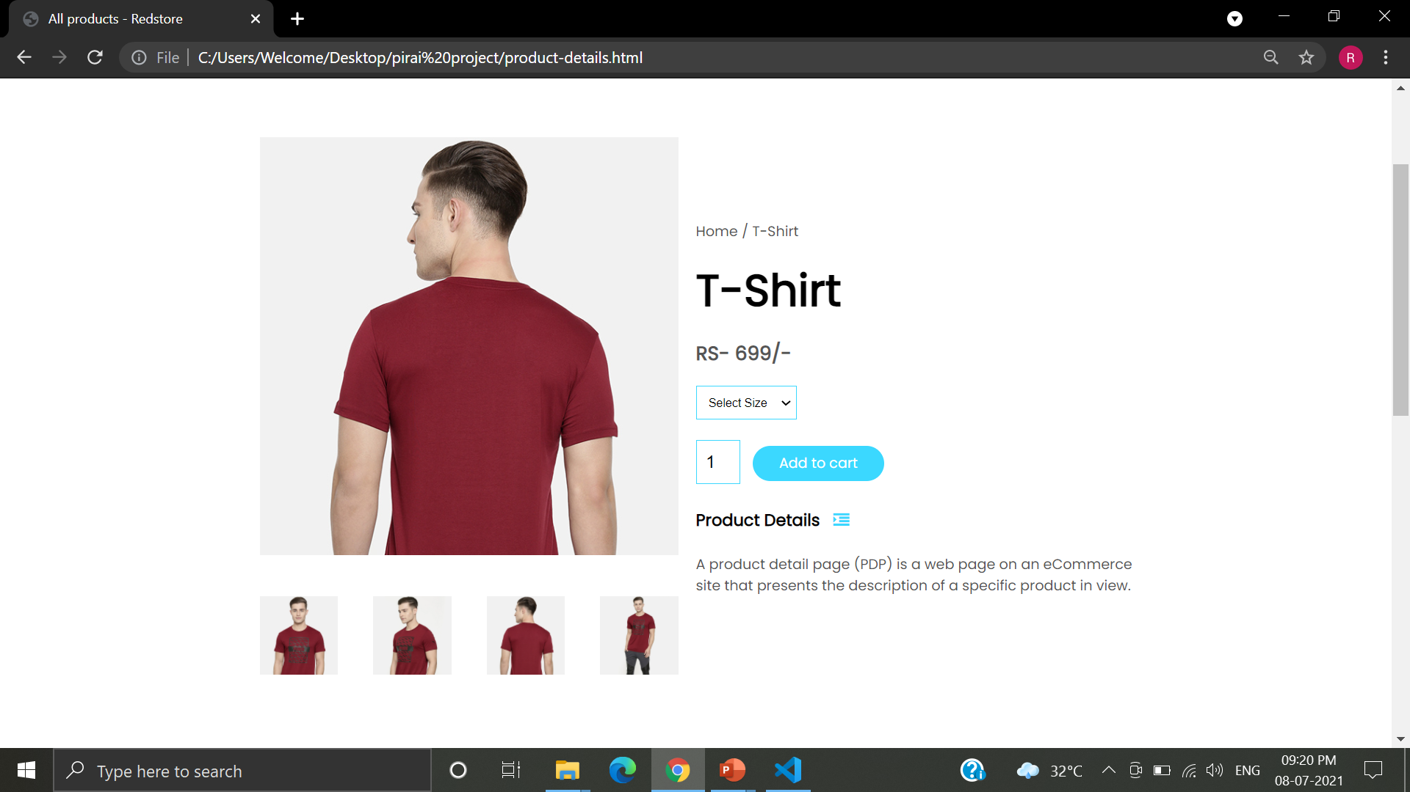
When we touch a images below it will show the different position of the t-shirt.

Slide 6
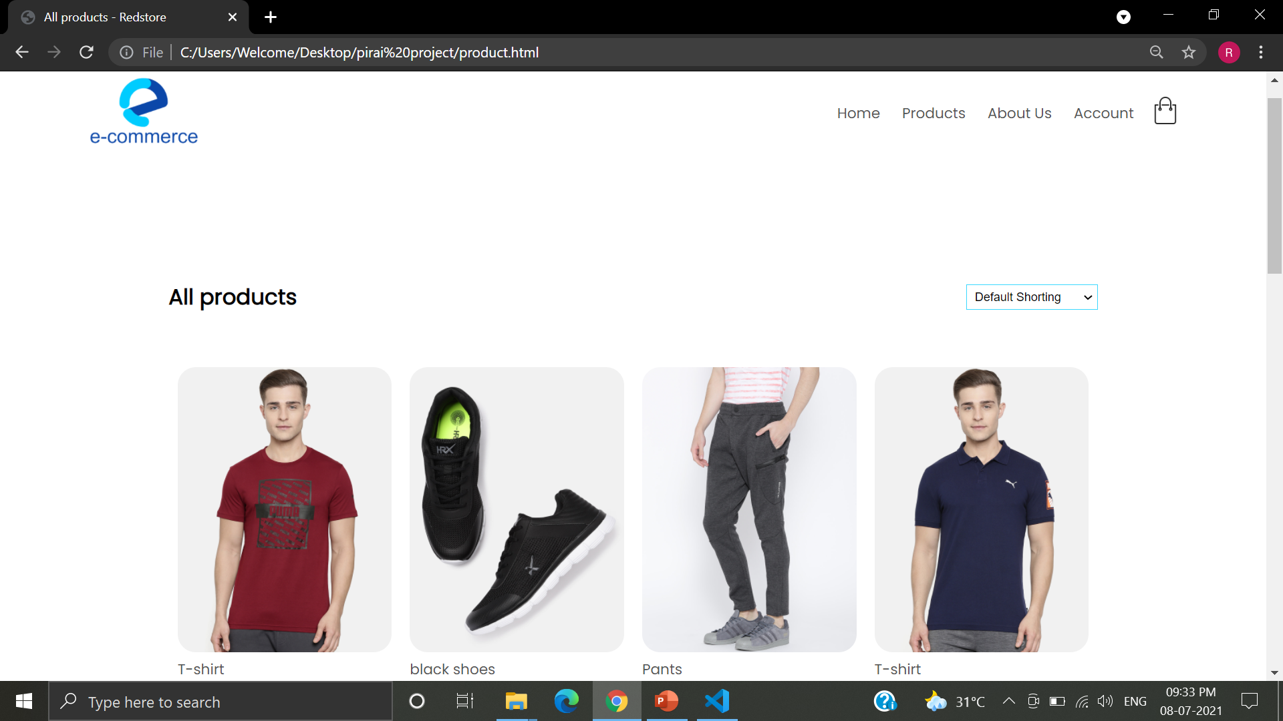
And in all product we can list the all products in e-commerce.

Slide 7
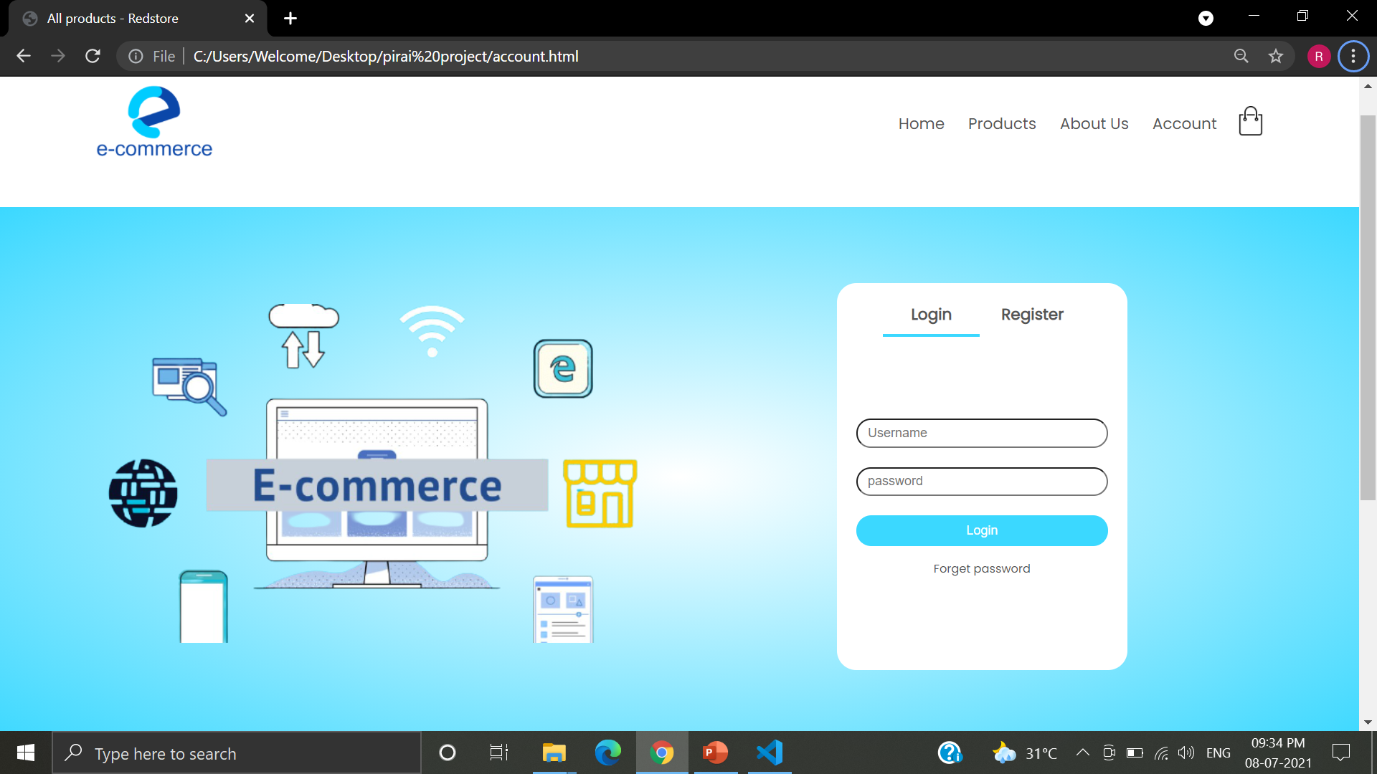
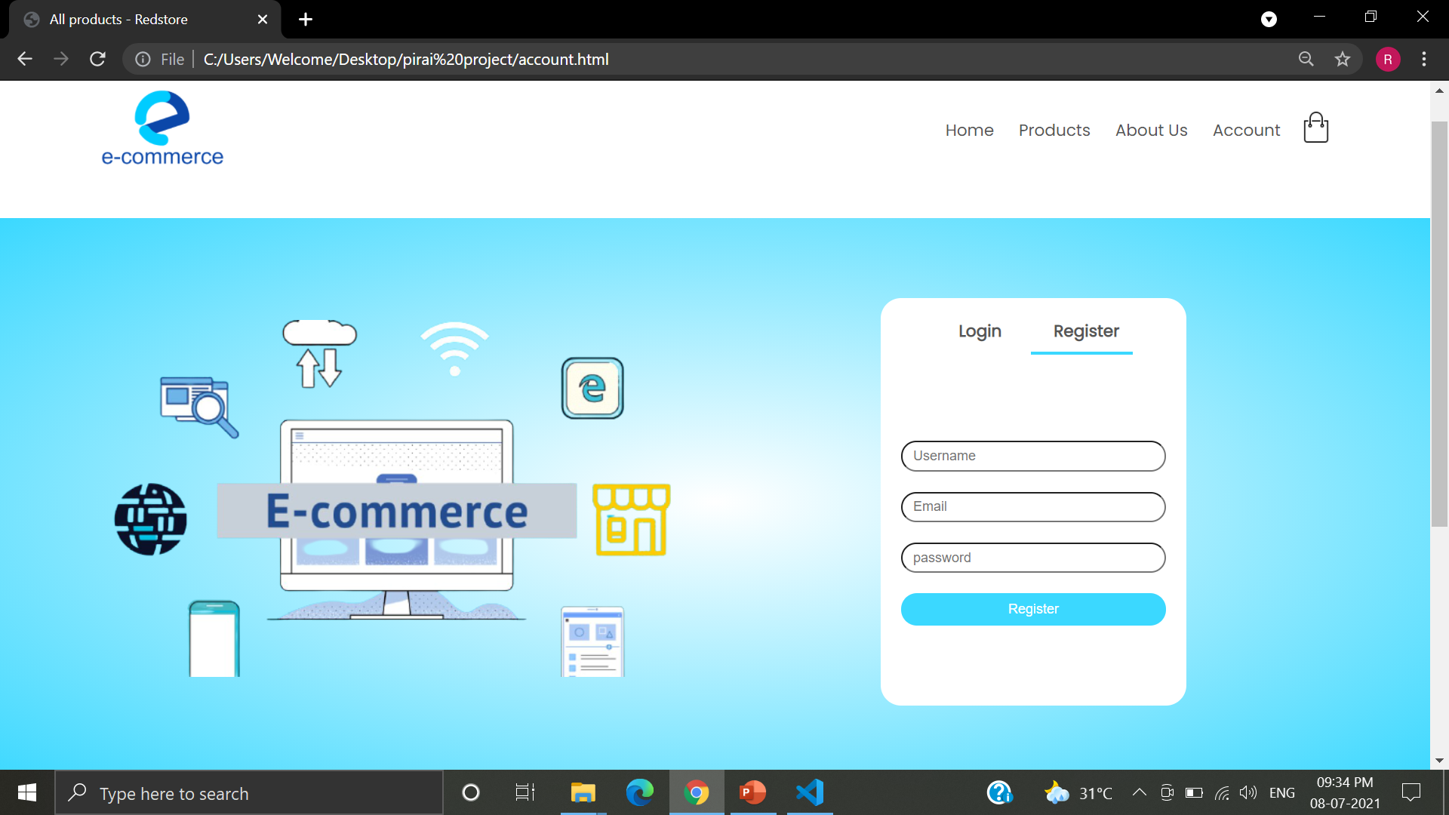
In account page we create a login id when we don’t have a account we can register also.

Slide 8
Thank you

